Slide 1
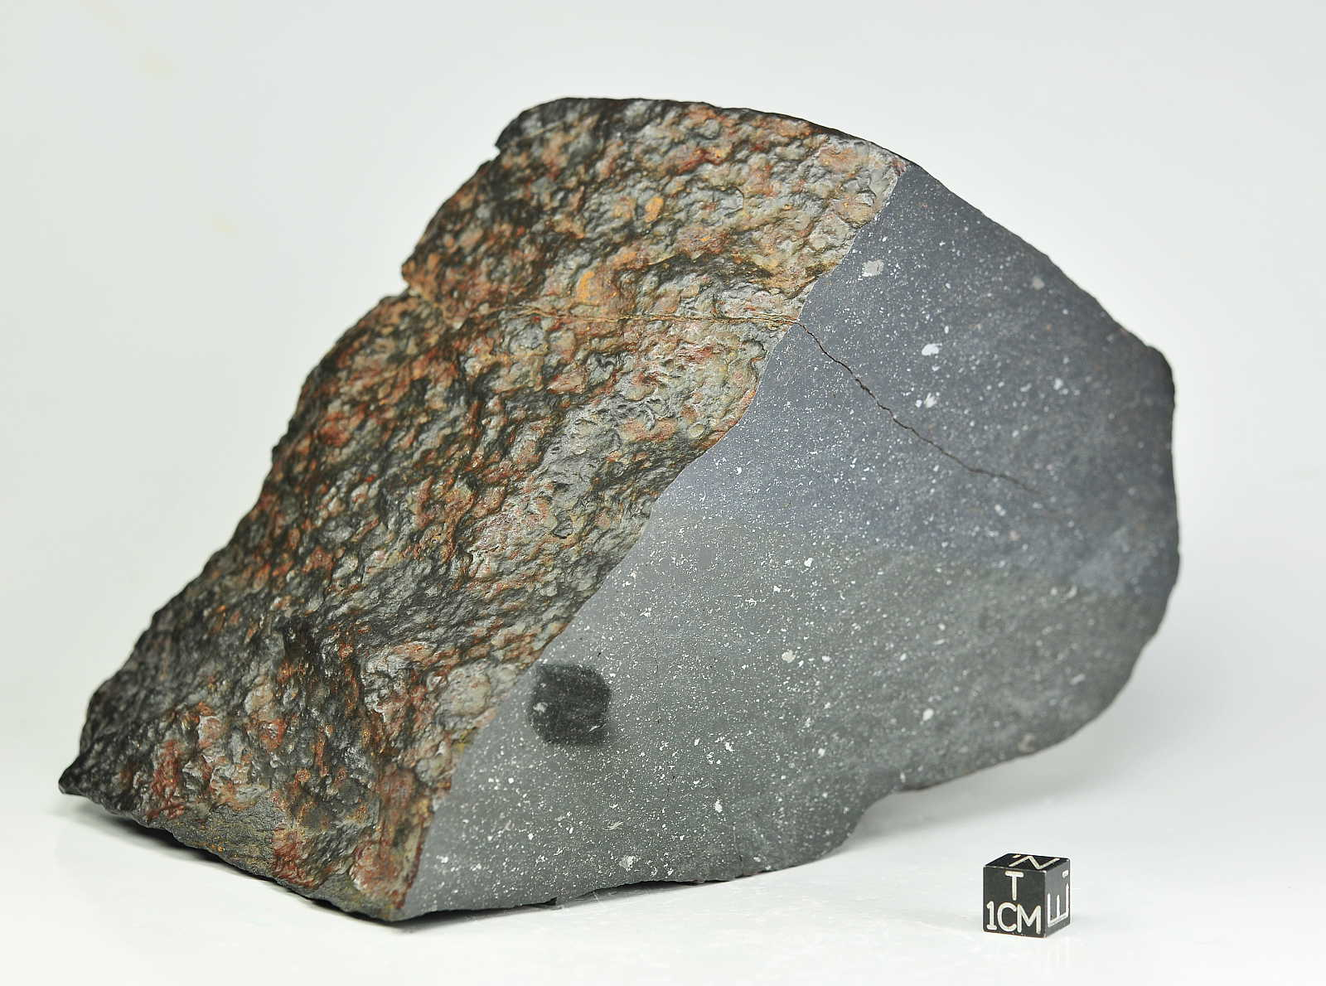


DO L-CHONDRITES COME FROM THE GEFION ASTEROID FAMILY?
Allison. M. McGraw¹, Vishnu Reddy¹, Juan A. Sanchez²
¹Lunar and Planetary Laboratory, University of Arizona
(ammcgraw@email.arizona.edu)
²Planetary Science Institute

Slide 2
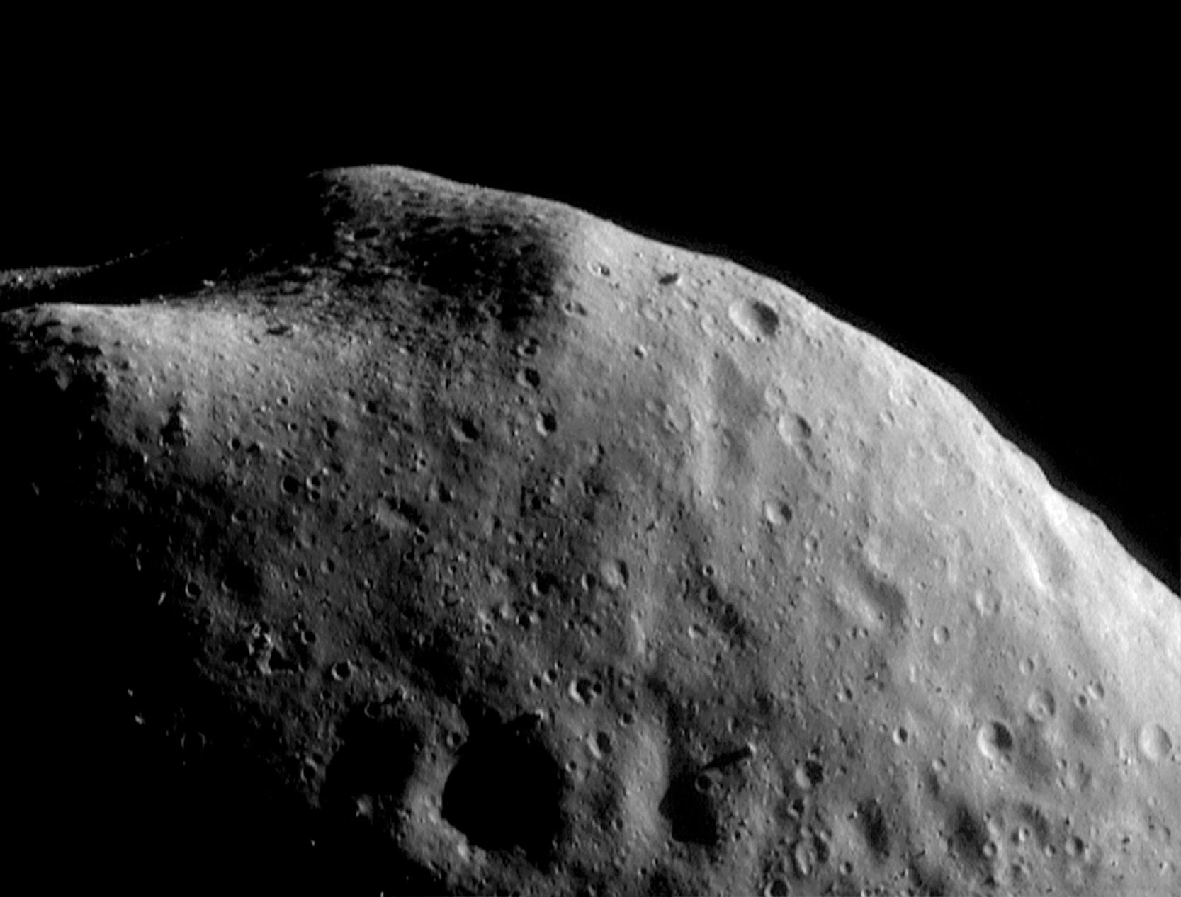
Asteroid-Meteorite Link
The linkage of meteorites to their source asteroids is an important goal of small body research.
At present time, there are <10 meteorite types linked to their parent body in the asteroid belt.
Ordinary chondrites are the dominant meteorite type to fall on Earth and are likely derived from some S-type asteroids.
H-, L-, and LL-chondrites are the three types of ordinary chondrites and differ in their metal abundance and silicate composition.
Our goal is to identify the source for the L chondrite meteorites in the main asteroid belt.
Here we present some preliminary results of this study.
Notes:
Read the bullet points
Meteorites are thought to be the product of the differentiation of their parent bodies.
Reaction melting allows meteorite bodies and parent bodies allows the partial differentiation to be constrained. Gaffey et al 1993

Slide 3
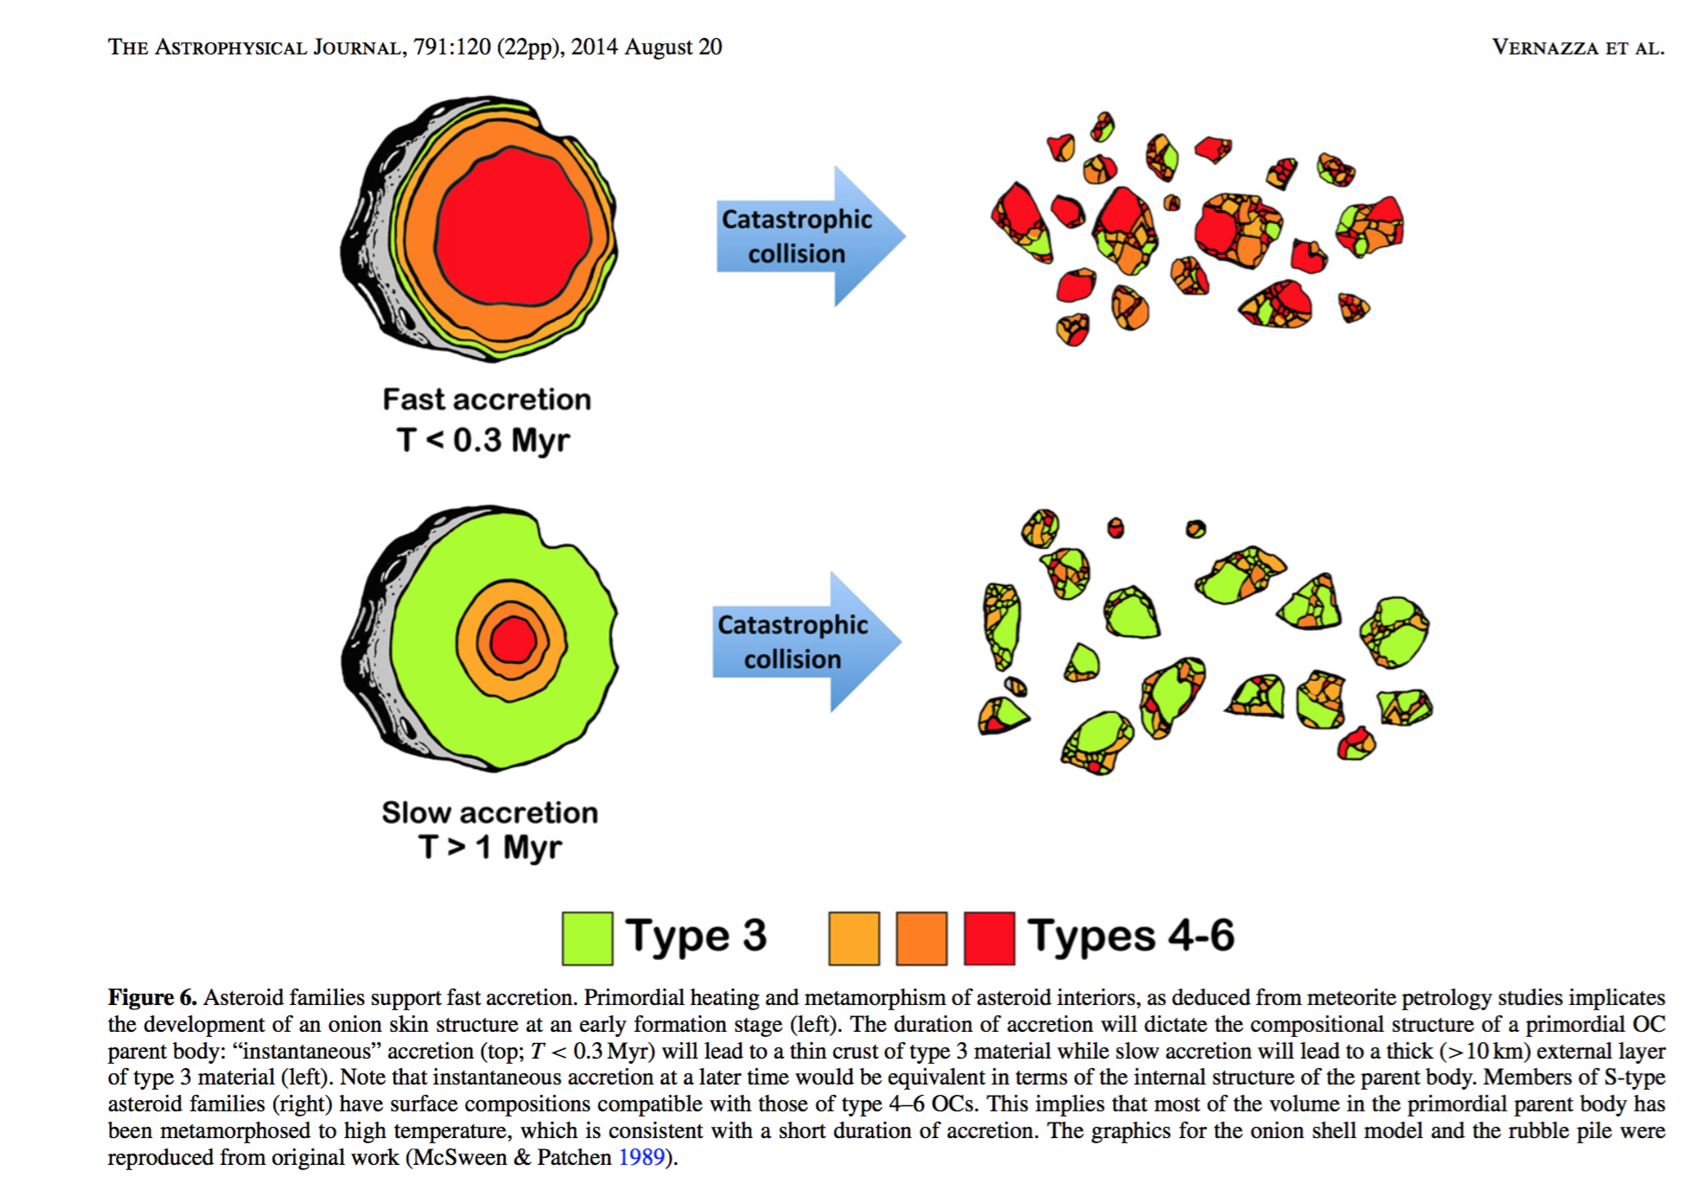

Slide 4
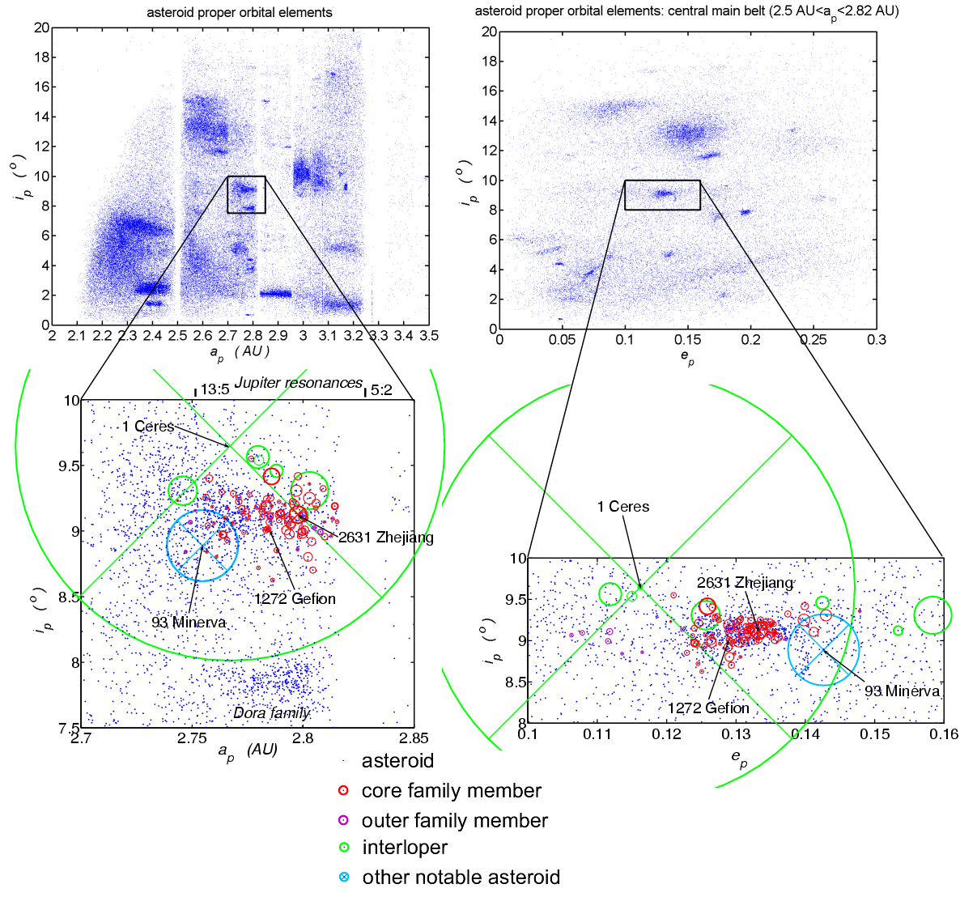
Gefion Family
Proposed source of the L-chondrite meteorites by various authors, Vernazza (2014) and Nesvorny (2009).
The family lies close to the 5:2 mean motion resonance with Jupiter, given the semimajor axis range of 2.7-2.82 AU (Nesvorny, 2009).
Notes:
First one discovered in 1930s. 766 members of the family now.
5:2 mean motion resonance is a good delivery system to meteorites to Earth.
Proposed L-chondrite delivery from Haack et al 1995

Slide 5
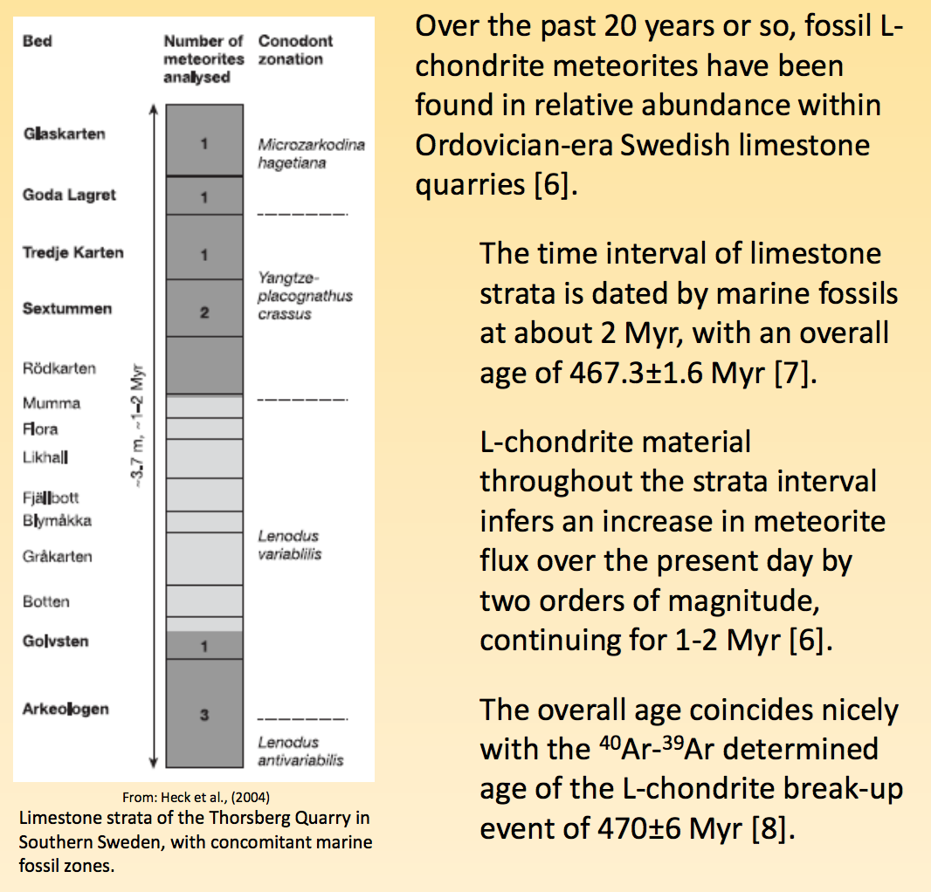

Slide 6
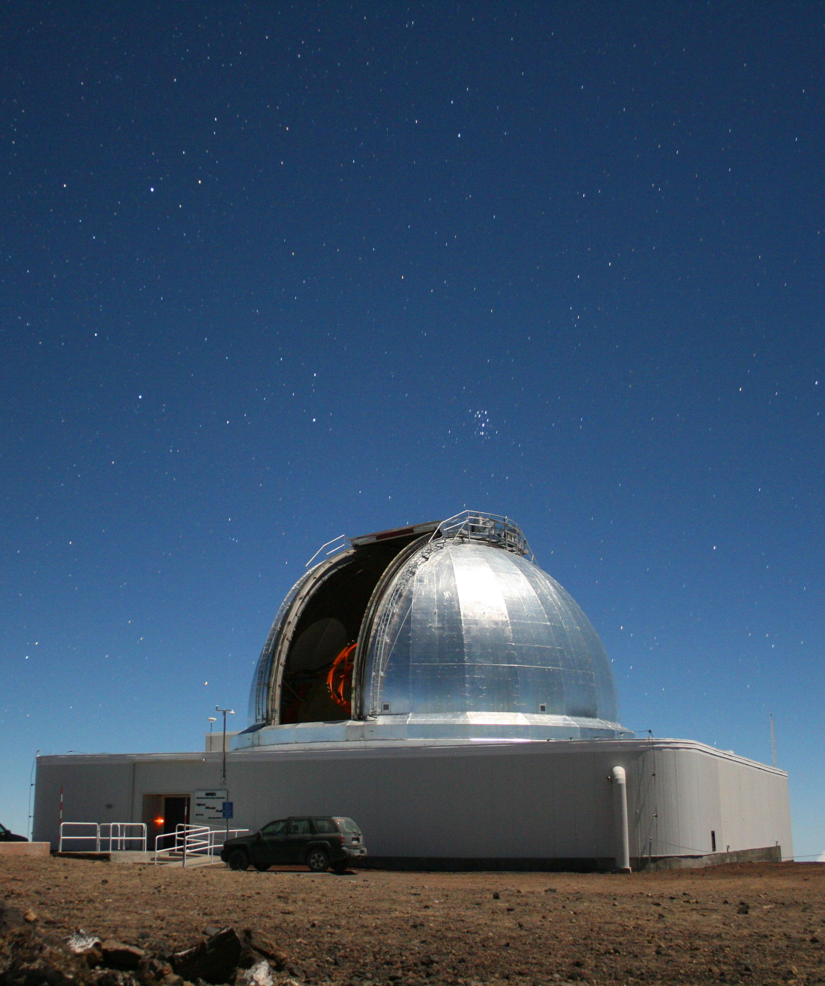
Observational Campaign
Started an observational asteroid (S-type) campaign to collect near-infrared (NIR) spectra (0.7-2.5 μm) of Gefion asteroids using the NASA IRTF on Mauna Kea, Hawaii in 2014.
This is still ongoing.
Here I will present results from the analysis of five asteroids:
(2386) Nikonov
(1839) Ragazza
(2373) Immo
(2521) Heidi
(3860) Plovdiv
NASA IRTF

Slide 7
Data Reduction
The spectral data were reduced using SpeXtool, an IDL-based data reduction software package provided by the NASA IRTF.
Spectral band parameters including Band center, and the Band Area Ratio (BAR) were measured using a Python code following the protocols described by Cloutis et al (1986).
Notes:
The data were reduced using Spextool provided by the NASA IRTF.
We extracted spectral band parameters including Band Centers and Band Area Ratios from these spectra.

Slide 8
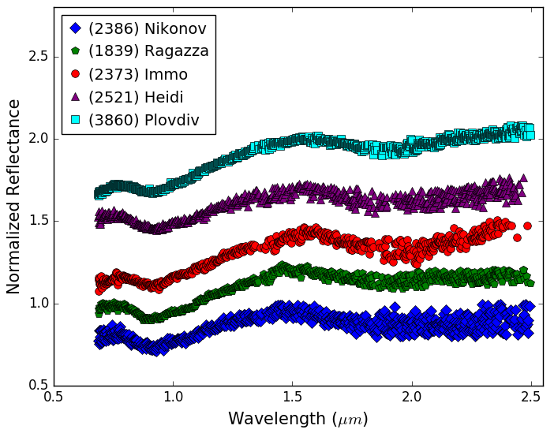
Results
Notes:
Here are the asteroid spectra I reduced. All spectra show two absorption bands. One centered around 1 micron and the other at 2 microns. And these absorption bands are caused by the presence of the minerals olivine and pyroxene.
I reduced 5 other asteroids…but these were the most decipheriable!

Slide 9
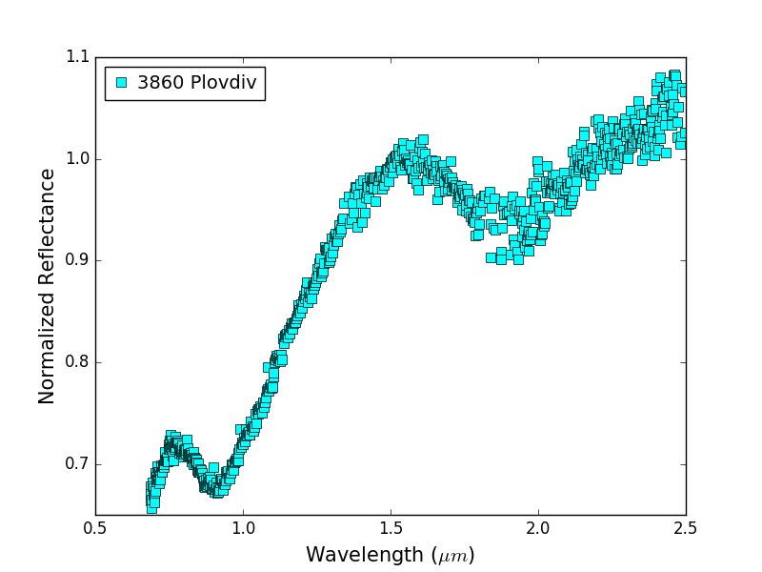
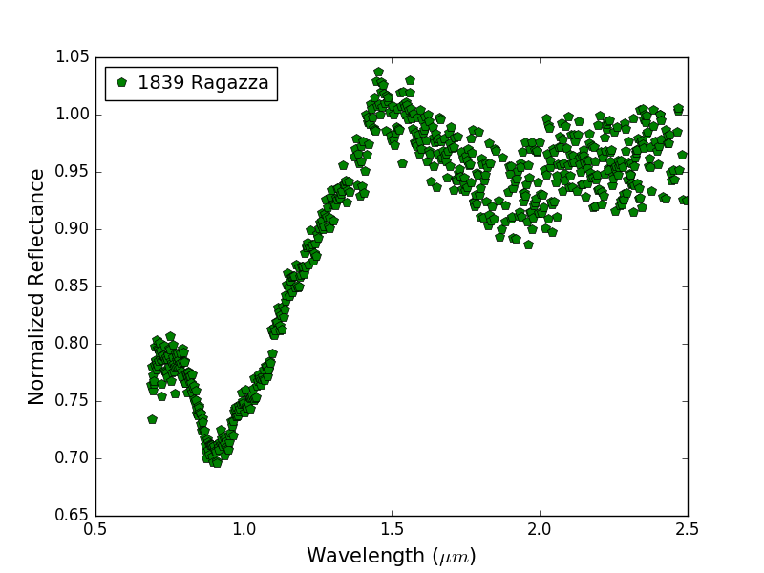
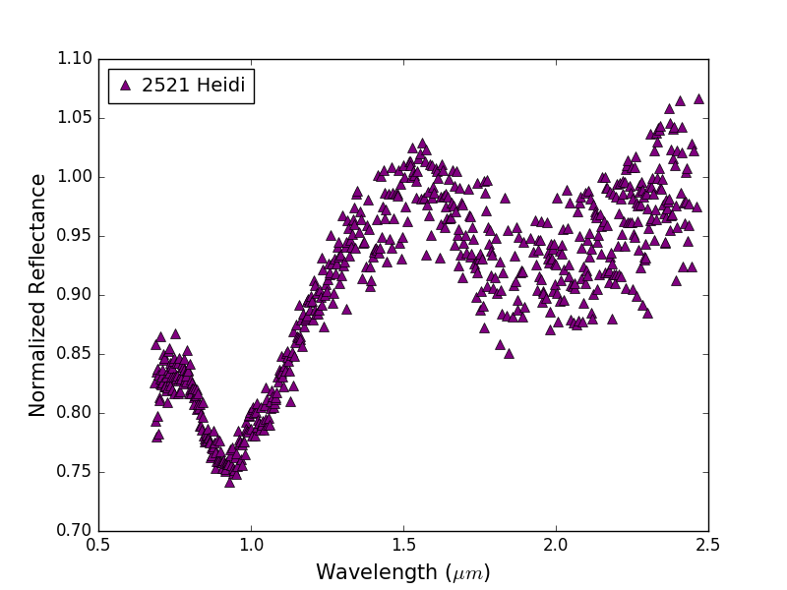
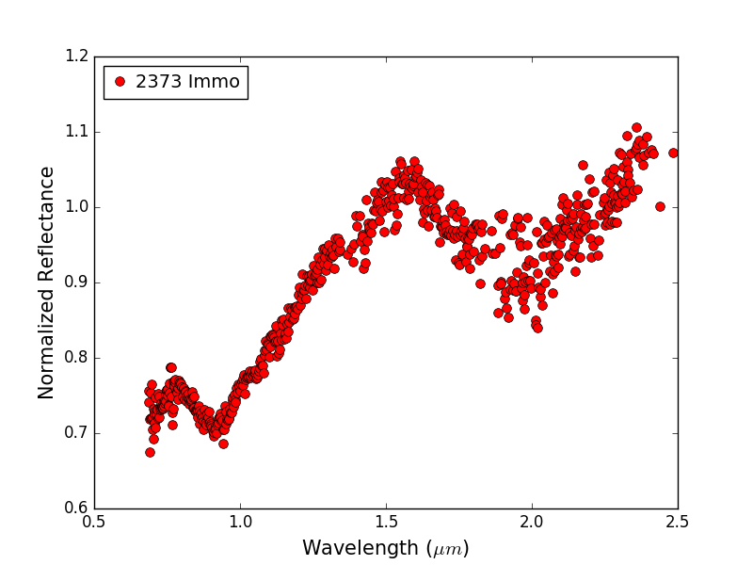
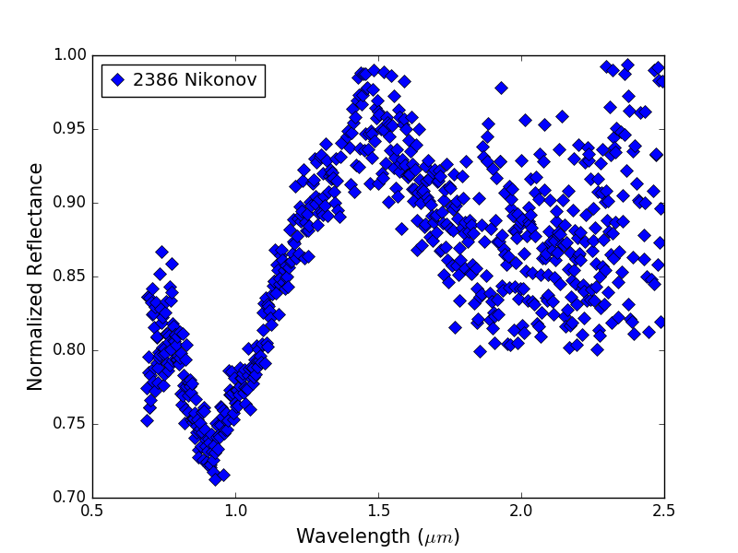
Notes:
Here are the asteroid spectra I reduced. All spectra show two absorption bands. One centered around 1 micron and the other at 2 microns. And these absorption bands are caused by the presence of the minerals olivine and pyroxene.

Slide 10
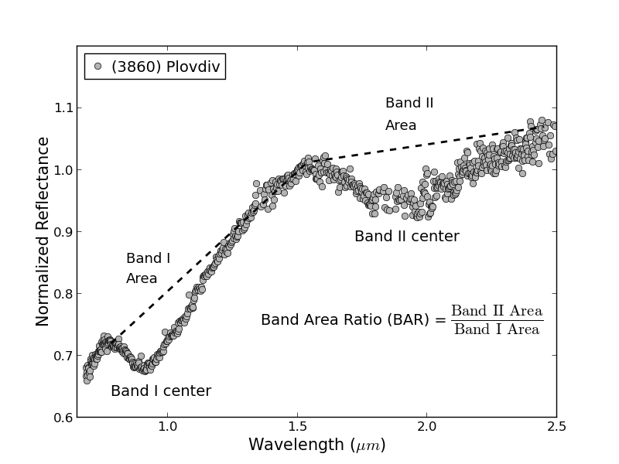
Results
Notes:
So what are these spectra band parameters. Here is a sample spectrum of one of our asteroids where we measured Band Center and Band Area for each of the absorption features. The ratio of Band II area to that of Band I area is the Band Area Ratio. These band parameters, especially the Band Centers are diagnostic of surface mineralogy of these asteroids.
laboratory calibrations confirm that band area ratio (BAR) is controlled by mineral abundances, while Band I center is controlled by mafic silicate compositions. Dunn et all 2009

Slide 11
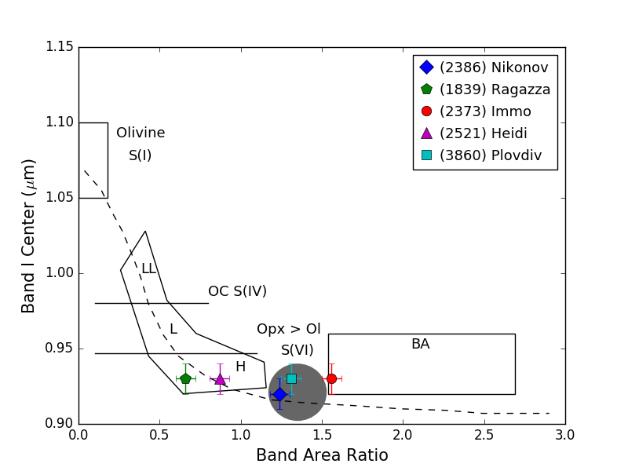
Results:
Band I Center VS. Band Area Ratio (BAR)
Mineralogy Subgroups: Gaffey et al (1993)
Notes:
Here is a plot of the Band I Center vs. Band Area Ratio from Gaffey et al. (1993) So what do we see here? Two of the observed asteroids have spectral band parameters that are consistent with H Chondrites. You can see them in the bottom of the boot shaped region. The next two asteroids fall in the S(VI) region. And the last asteroid falls in the Basaltic Achondrite region. I will discuss the results and implications of these plotting locations.
Mineralogical subgroups by Gaffey et al (1993)
The dashed line is the olivine-opx mising line as defined by Cloutis et al 1986

Slide 12
Results for Ragazza and Heidi
Laboratory spectral calibrations derived by Dunn et al (2010) were used to determine the surface composition of (1839) Ragazza and (2521) Heidi.
The olivine and pyroxene chemistry, which are given by the molar content of fayalite (Fa) and ferrosilite (Fs), respectively, are consistent with that of H chondrites.
Similarly, the olivine abundances (ol/(ol+px)) for these two asteroids were found to be consistent with H-chondrites.
Notes:
We used spectral calibrations derived from Dunn et al to constrain the composition of two H chondrite like asteroids. We can confirm that their fayalite and ferrosilite content are similar to H chondrites. We also found that their olivine to pyroxene ratio matches with those of H chondrites.

Slide 13
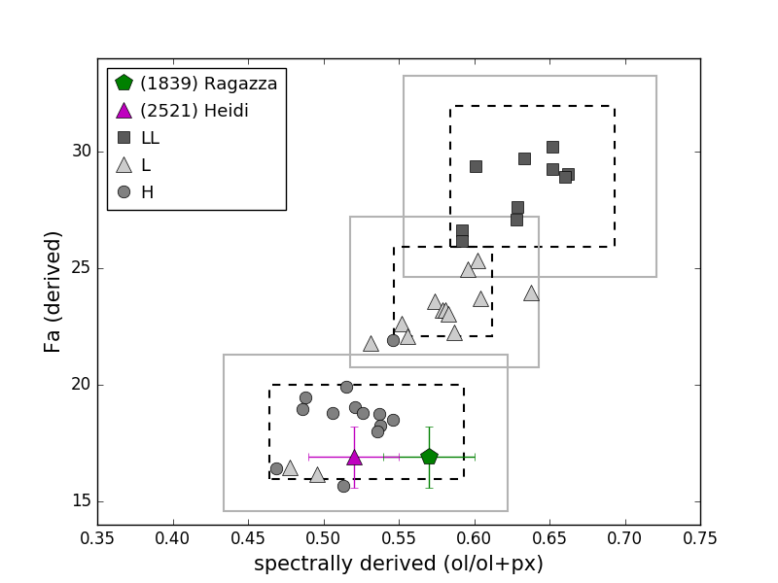
Molar content of Fayalite vs. ol(ol+px)
Notes:
Here we have Fayalite and olivine pyroxene ratio plotted for ordinary chondrites from the laboratory measurements and spectrally derived values of the same for our two asteroids. As you can see they are falling in the H chondrite box.
Error bars, same errors because they has same BI center values, thus the calculation was the same.

Slide 14
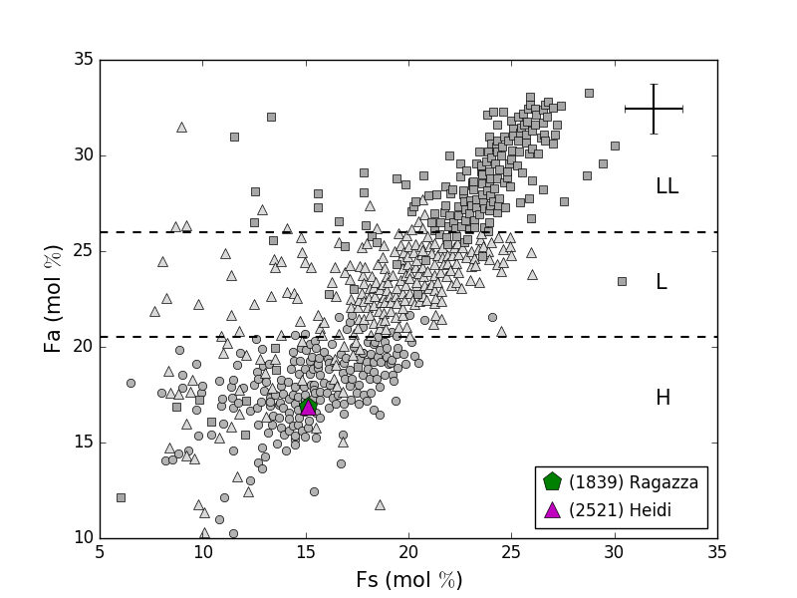
Fayalite (Fa) VS Ferrosilite (Fs) Molar Content
Notes:
Here we have Fayalite and Ferrosillite plotted for ordinary chondrites from the lab and spectrally derived values of the same for our two asteroids. As you can see they are falling in the H chondrite box. The error bar on the top right are the uncertainties in the Fa and Fs estimates for the asteroid from Dunn equations.

Slide 15
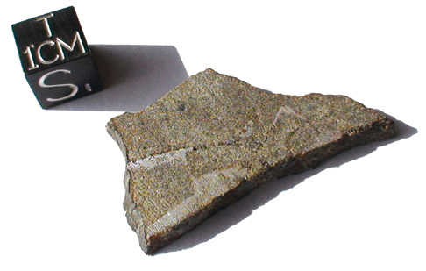
Analogs for Ragazza and Heidi
Possible meteorite analogs for Ragazza and Heidi may include H-chondrites (high iron content)
Rich in Opx (orthopyroxene) and olivine
Image credit: Meteorite.fr

Slide 16
Band I Center VS. Band Area Ratio (BAR)
Notes:
Now let us look at the next two asteroids in the S(VI) region) and the lone asteroid in the Basaltic Achondrite region.

Slide 17
Results for Nikonov, Plovdiv and Immo
(2386) Nikonov and (2860) Plovdiv suggests surfaces with higher orthopyroxene content than olivine.
(2373) Immo dominated by orthopyroxene.
We used equations derived by Burbine et al (2007) to determine the pyroxene chemistry of these asteroids.
Notes:
Cloutis et al 1986 olivine-orthopyroxene mixing

Slide 18
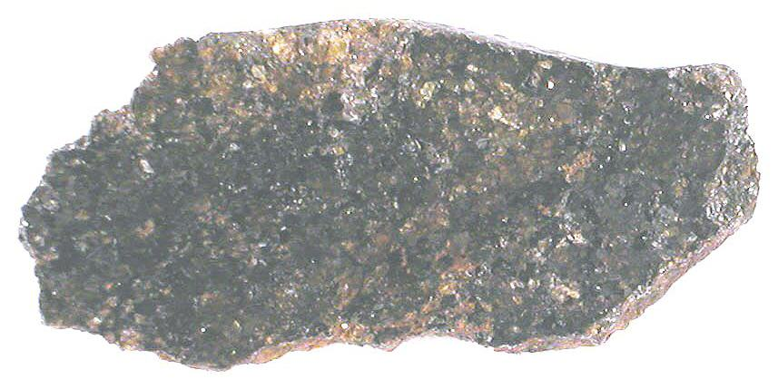
Analogs for Nikonov and Plovdiv
Possible meteorite analogs for Nikonov and Plovdiv would include primitive achondrites such as acapulcoites and lodranties based on work by Lucas et al. They suggested these meteorites to be analogs for S(VI) types.
Acapulcoite meteorite: Northwest Africa 2627
Image credit: Jim Strope

Slide 19
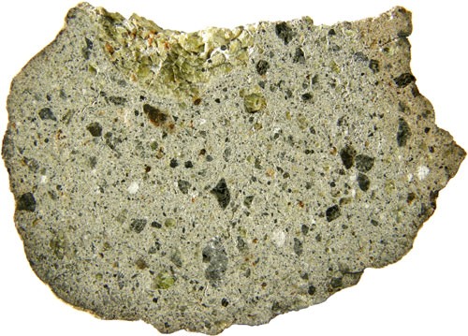
Analogs for Immo
Basaltic achondrites like howardites, eucrites and diogenites (HED), are probably better meteorite analogs for Immo.
NWA 4934 Howardite
Image credit: Meteorites Austrailia

Slide 20
Summary
The results from these observation indicates the following:
- Some members of the Gefion family have composition similar to H-chondrites, primitive achondrites and basaltic achondrites.
- No evidence for L-chondrites among the Gefion family members in our small sample study.
Vernazza et al (2014) suggested that the Gefion family is a mixture of both H-, and L-chondrites. Our observations partly support this finding as we found (1839) Ragazza and (2521) Heidi to have compositions similar to H- chondrites.
The three other asteroids with non-ordinary chondrite compositions might be interlopers in the Gefion family.
Notes:
Interlopers; Ceres and Minevera familes
Started out asking the question if the Gefion family is the parent source for L-chondrites, and found that none of these are consistent with L-chondrites! This is a very small sample and needs more observations to fully answer the question if L-chondrites come from the Gefion asteroid family

Slide 21
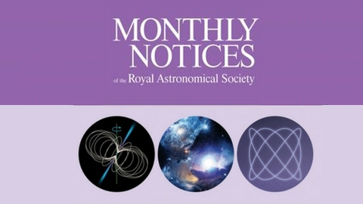
Futuristic happenings
Preliminary results
Ongoing observational asteroid campaign
These results will be published later this year in MRNAS

Slide 22




Acknowledgments
This work was funded by the NASA Undergraduate Arizona Space Grant Consortium and the Office of Research, Development and Innovation at the University of Arizona.

Slide 23
Backup Slides!

Slide 24
Olivine and Pyroxene
Object | Fa (mol%) | Fs (mol%) | Wo (mol%) | ol(ol+px)
Nikonov | --- | 27.7 ± 3.3 | 3.9 ± 1.1
Ragazza | 16.9 ± 1.3 | 15.1 ± 1.4 |  | 0.57 ± 0.03
Immo |  | 37.9 ± 3.3 | 7. 9 ± 1.1
Heidi | 16.9 ± 1.3 | 15.1 ± 1.4 |  | 0.52 ± 0.03
Plovdiv |  | 37.9 ± 3.3 | 7.9 ± 1.1

Slide 25
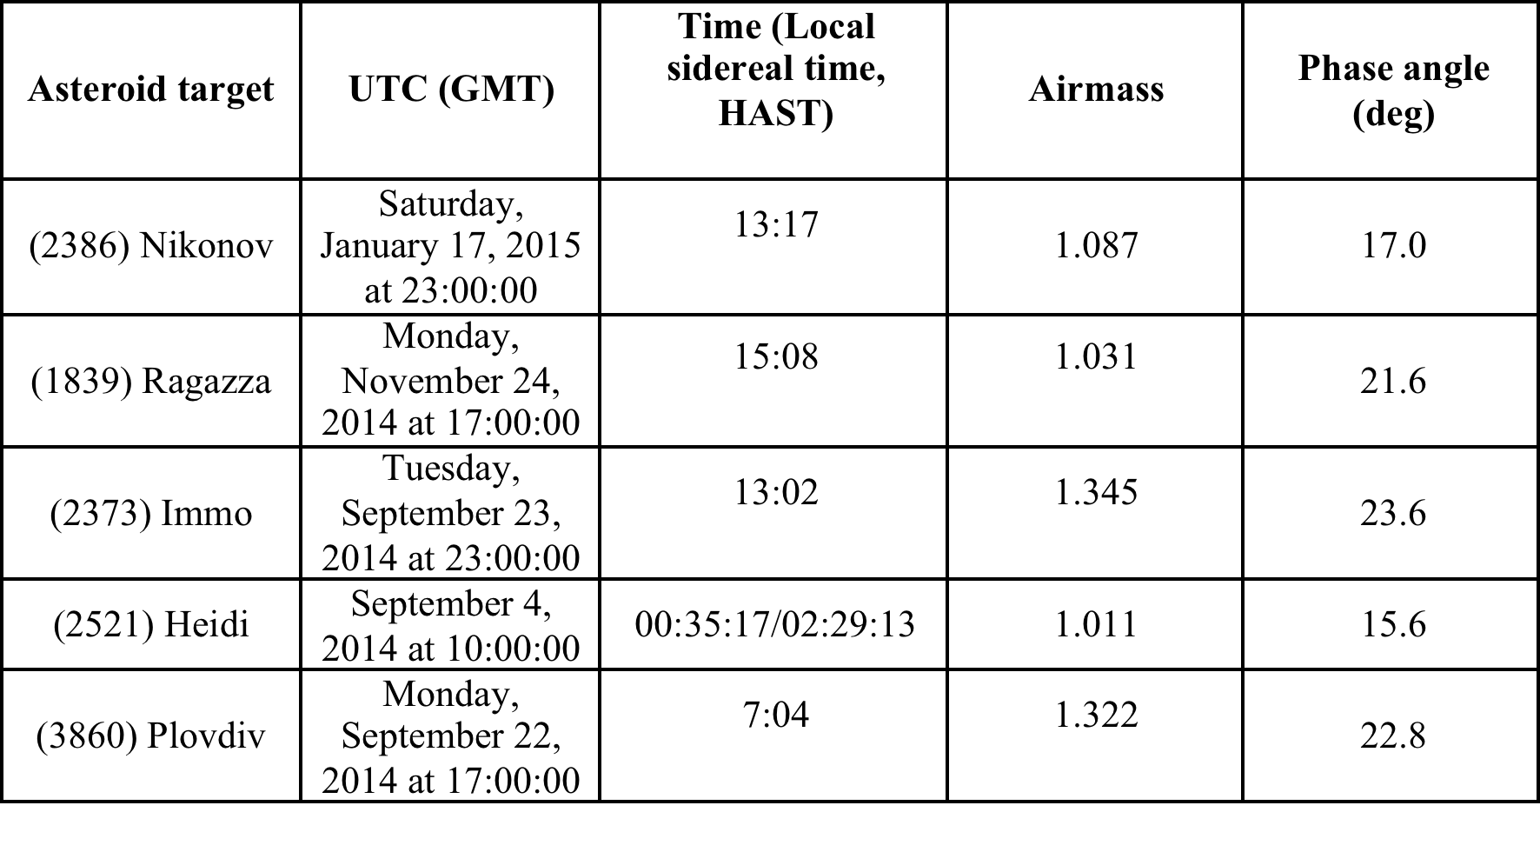

Slide 26
